Slide 1

Large Scale Data Driven Applications
Replication and Sharding in MongoDB

Slide 2
Outlines
By the end of this lecture, students should be able to:
Understand the purpose of replication and sharding in MongoDB.
Describe the concepts and components of replication and sharding.
Differentiate between replication and sharding and explain when to use each.

Slide 3
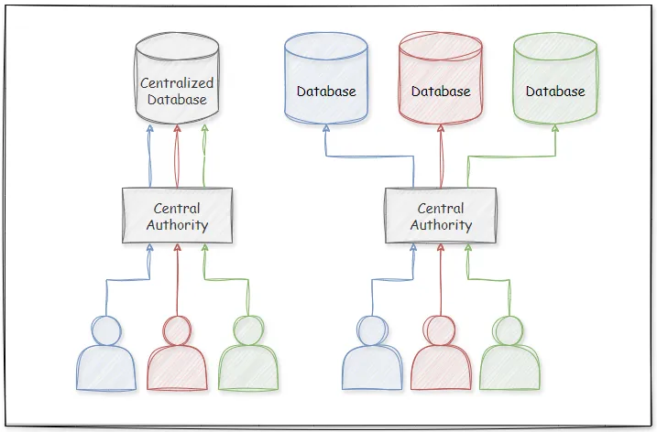
Overview of MongoDB as a Distributed Database
MongoDB is a document-oriented, NoSQL database built to handle large-scale applications with unstructured or semi-structured data.
Why Distributed Databases?
Traditional databases often struggle with scalability and availability in high-traffic or large-data scenarios.
Distributed databases allow data to be stored across multiple machines, improving scalability and redundancy.
Centralised VS distributed databases
Image source: https://medium.com/towards-data-engineering/data-intensive-system-building-blocks-distributed-databases-4af9e3de98c5

Slide 4
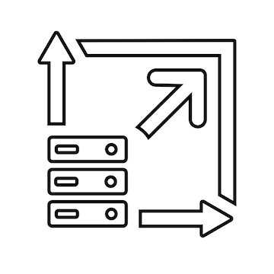
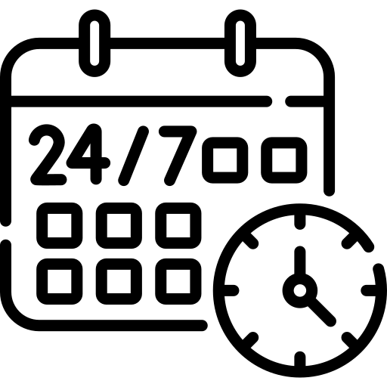
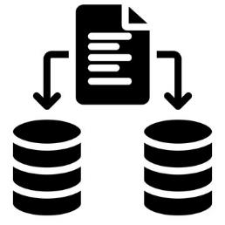
Challenges Addressed by Replication and Sharding
Parallelism: Critical applications require 24/7 availability; any downtime can lead to significant losses.
Scalability and Flexibility: Large applications often exceed single-machine capacity, needing horizontal scaling to manage large datasets and high loads.
Fault Tolerance: Protects against data loss and provides fault tolerance.
Availability
Scalability and Flexibility
Redundancy

Slide 5
What are Replication and Sharding in MongoDB?
Replication: Copies data across multiple nodes to ensure data redundancy, fault tolerance, and high availability.
Make data available even if one or more servers fail.
Sharding: Divides large datasets across multiple machines to enable horizontal scaling.
Handle large data volumes and distribute the load, improving read and write performance.

Slide 6
What We’ll Cover Today
Replication in MongoDB: Concepts, components, benefits, and use cases.
Sharding in MongoDB: Concepts, components, benefits, and use cases.
Comparison and Best Practices: When to use each, how to implement, and best practices for combining replication and sharding.

Slide 7
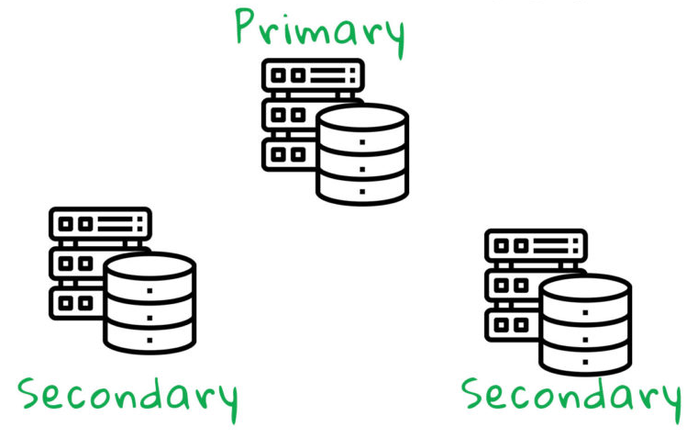
What is Replication?
Replication is a group of mongod processes that keep the same data across multiple servers.
Replication provides redundancy and increases data availability with multiple copies of data on different database servers.
Replication protects a database from the loss of a single server. Replication also allows you to recover from hardware failure and service interruptions.
With extra copies of the data, you can give one to disaster recovery, reporting, or backup.
Source: https://www.ithack.it/knowledge-base/replication-in-mongodb/

Slide 8
How Replication Works in MongoDB
MongoDB achieves replication by the use of replica set.
A replica set is a group of MongoDB servers that maintain the same data set. In a replica set, one node is primary node that receives all write operations.
A group of two or more nodes (generally minimum 3 nodes are required).
All other instances, such as secondaries, apply operations from the primary so that they have the same data set.
Replica set can have only one primary node.
Each replica set node must belong to one, and only one, replica set. Replica set nodes cannot belong to more than one replica set.

Slide 9
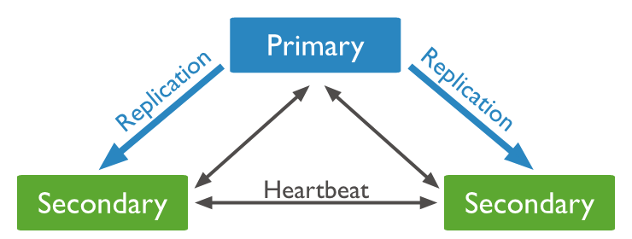
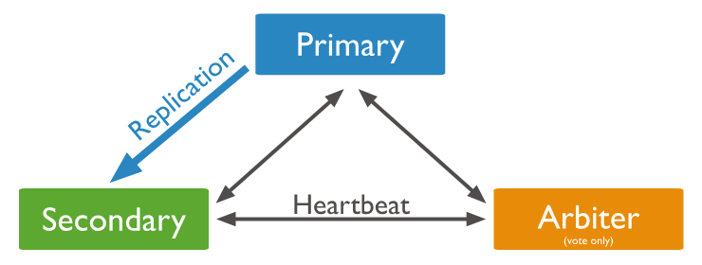
How Replication Works in MongoDB
Primary Node: Handles all write operations and synchronises data with secondary nodes.
Secondary Nodes: Replicate data from the primary and can be promoted to primary if the original primary fails.
If the primary fails, an election is hold to select a new primary
If cost constraints prevent adding a secondary, consider adding a mongod instance as an arbiter to the replica set.
Arbiter Node: Participates in elections but does not store data, ensuring an odd number of voting members to avoid split-brain scenarios.

Slide 10
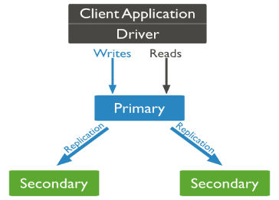
How Replication Works in MongoDB
The primary node receives all write operations and records changes in the oplog (operation log).
Secondary nodes continuously copy changes from the primary's oplog and apply them to their own data sets.
Secondary nodes may lag slightly behind the primary but are eventually consistent.

Slide 11
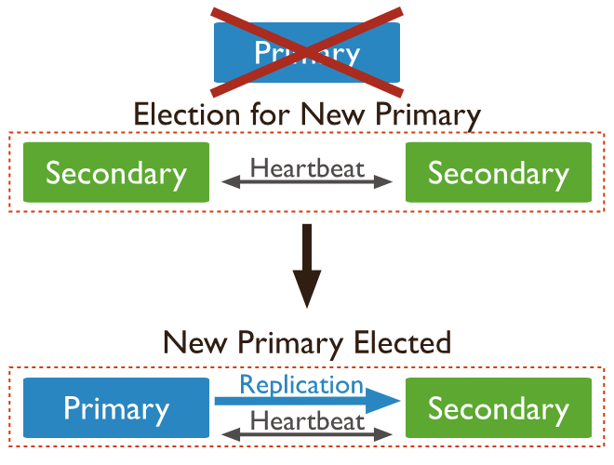
Automatic Failover and Elections in Replica Sets
MongoDB performs automatic failover if the primary node goes down, promoting one of the secondary nodes to primary.
Secondary nodes vote to elect a new primary, with the arbiter (if present) assisting in achieving a majority.
After the recovery of the failed node, it again join the replica set and works as a secondary node.
Failover ensures minimal downtime and maintains high availability.

Slide 12
Read and Write Concerns
Write Concern: Determines how many nodes must acknowledge a write operation before considering it successful (e.g., majority, all).
Read Concern: Specifies the level of consistency required for read operations (e.g., primary, primaryPreferred, or secondary).
Primary: Reads from the primary node only (strong consistency).
PrimaryPreferred: Reads from primary but can switch to secondaries if the primary is unavailable.
Secondary: Reads from secondary nodes (for load balancing).

Slide 13
Set Up a Replica Set (Command-Line Approach)
To convert to replica set, following are the steps:
Shutdown already running MongoDB server.
Start the MongoDB server by specifying -- replSet option. Following is the basic syntax for starting a MongoDB server instance and configure it to be part of a replica set
mongod --port "PORT" --dbpath "YOUR_DB_DATA_PATH" --replSet "REPLICA_SET_INSTANCE_NAME"
--port “PORT”: Specifies the port number on which the MongoDB server instance will listen for connections
--dbpath “YOUR_DB_DATA_PATH”: Specifies the file path to the directory where the MongoDB instance stores its data files.
--replSet “REPLICA_SET_INSTANCE_NAME”: Specifies the name of the replica set to which this MongoDB instance belongs.

Slide 14
Set Up a Replica Set (Command-Line Approach)
Example: To start a MongoDB instance on port 27017, storing data in /data/db1, and part of a replica set named rs0:
mongod --port 27017 --dbpath /data/db1 --replSet rs0
Use the mongo shell to connect to this instance as follows.
mongo --port 27017
In Mongo client, issue the command rs.initiate() to initiate a new replica set.
To check the replica set configuration, issue the command rs.conf()
To check the status of replica set issue the command rs.status().

Slide 15
Set Up a Replica Set (Configuration Files)
Add Members to Replica Set
Ensure MongoDB is installed on all machines intended to be part of the replica set.
Create a separate configuration file for each instance, specifying the port and database paths for each MongoDB instance. Example (mongod1.conf for Instance 1):
replication:
replSetName: "rs0" # Name of the replica set
net:
port: 27017
storage:
dbPath: "/data/db1"
Start each MongoDB instance with its corresponding configuration file. Use the --config option to specify the configuration file.
mongod --config /path/to/mongod1.conf
mongod --config /path/to/mongod2.conf
mongod --config /path/to/mongod3.conf

Slide 16
Set Up a Replica Set (Configuration Files)
Add Members to Replica Set
Connect to one of the running MongoDB instances using the mongo shell. For example:
mongo --port 27017
Run the rs.initiate() command to initialise the replica set. This command configures the current instance as the primary.
rs.initiate({
_id: "rs0", // Replica set name (must match "replSetName")
members: [
{ _id: 0, host: "localhost:27017" }, // Instance 1
{ _id: 1, host: "localhost:27018" }, // Instance 2
{ _id: 2, host: "localhost:27019" } // Instance 3
]
});

Slide 17
Set Up a Replica Set
Adding a Member to a Replica Set
Use the rs.add() command to add a new member to the replica set. Example:
rs.add("localhost:27020");
Removing a Member from a Replica Set
Use the rs.remove() command to remove the specified member from the replica set.
rs.remove("localhost:27019");

Slide 18
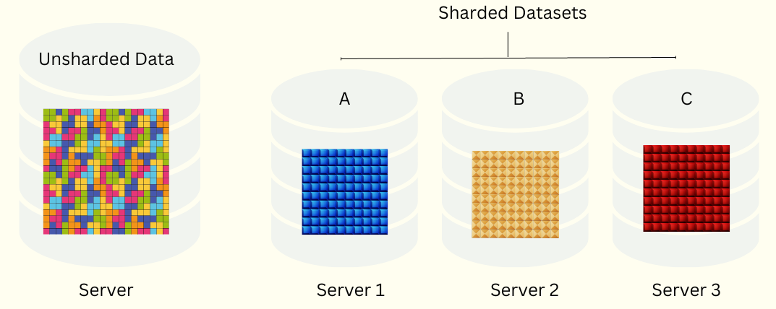
Sharding in MongoDB
Sharding is a method for distributing data across multiple machines.
MongoDB sharding splits data into chunks and distributes them across multiple shards.
Sharding in MongoDB is critical for scalability in distributed systems.
Source: https://www.atatus.com/blog/database-sharding-what-is-it-and-how-it-works/
Database systems with large data sets can challenge the capacity of a single server.
For example, high query rates can use the CPU capacity of the server, and these stress the I/O capacity of disk drives.
There are two methods for addressing system growth: vertical and horizontal scaling.
Vertical Scaling
Horizontal Scaling

Slide 19
Sharding in MongoDB
Two methods for addressing system growth
Vertical Scaling involves
Increasing the capacity of a single server, such as using a more powerful CPU, adding more RAM, or increasing the amount of storage space.
Limitations in available technology may restrict a single machine from being sufficiently powerful for a given workload.
Additionally, Cloud-based providers have hard ceilings based on available hardware configurations. As a result, there is a practical maximum for vertical scaling.

Slide 20
Sharding in MongoDB
Two methods for addressing system growth
Horizontal Scaling involves
Dividing the system dataset and load over multiple servers, adding additional servers to increase capacity as required.
While each machine may have limited speed or capacity, distributing the workload across multiple machines can achieve greater efficiency than relying on a single high-performance server.
Expanding the capacity of the deployment only requires adding additional servers as needed, which can be a lower overall cost than high-end hardware for a single machine.
The trade off is increased complexity in infrastructure and maintenance for the deployment

Slide 21
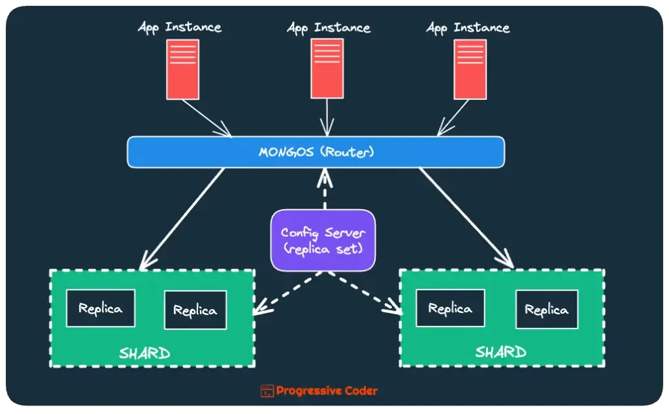
Components of a Sharded Cluster
Shards: Store subsets of the dataset. Each shard is a replica set for redundancy and fault tolerance.
Config Servers: Store metadata and manage the cluster's mapping of data to shards.
Query Routers (mongos): Route client requests to the appropriate shards based on the shard key.
https://progressivecoder.substack.com/p/mongodb-sharding-architecture

Slide 22
Shard Keys and Data Distribution
Shard Key: A field or combination of fields used to determine how data is distributed across shards.
product_id | product_name | price | quantity | category
1 | Laptop | 10.99 | 11 | Electronics
2 | Shirt | 13.65 | 16 | Clothing
3 | Headphone | 12.90 | 30 | Electronics
4 | Toothpaste | 132.72 | 5 | Home
5 | Hat | 10.11 | 70 | Clothing
shard the store table based on the category column
product_id | product_name | price | quantity | category
1 | Laptop | 10.99 | 11 | Electronics
3 | Headphone | 12.90 | 30 | Electronics
Shard 1 - Electronics
product_id | product_name | price | quantity | category
2 | Shirt | 13.65 | 16 | Clothing
5 | Hat | 10.11 | 70 | Clothing
Shard 2 - Clothing
Shard 3 - Home
product_id | product_name | price | quantity | category
4 | Product D | 132.72 | 5 | Home

Slide 23
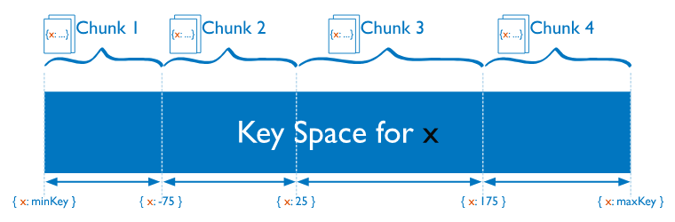
Types of Sharding
Range-Based Sharding: Data is divided into contiguous ranges based on the shard key.
A relatively simple approach for sharding and gives you a meaningful way to map data to shards.
Depending on how you’re picking these ranges, you can easily overload shards.

Slide 24
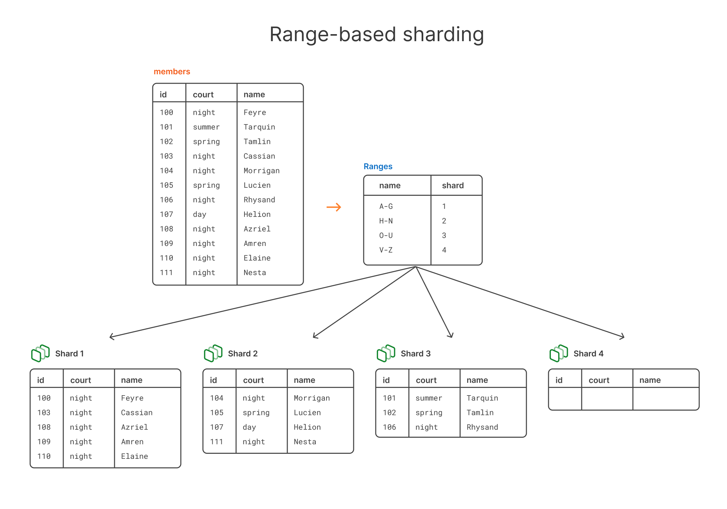
Types of Sharding
Range-Based Sharding: Example
Source: https://planetscale.com/blog/types-of-sharding

Slide 25
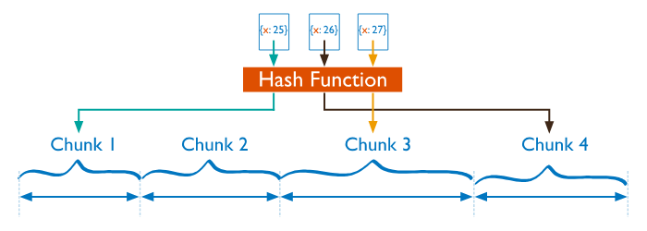
Types of Sharding
Hashed Sharding: Data is distributed based on a hash of the shard key value.
Uses either a single field hashed index or a compound hashed index as the shard key to partition data across your sharded cluster
This method takes human guesswork out of the equation.
Instead of relying on humans to estimate data distribution across ranges, hashing ensures an even distribution, provided the shard key has high cardinality.
There’s less chance of overloading a shard because you’re distributing the data based on a well-proven hash function.
The main downside of this approach is having the extra hashing step

Slide 26
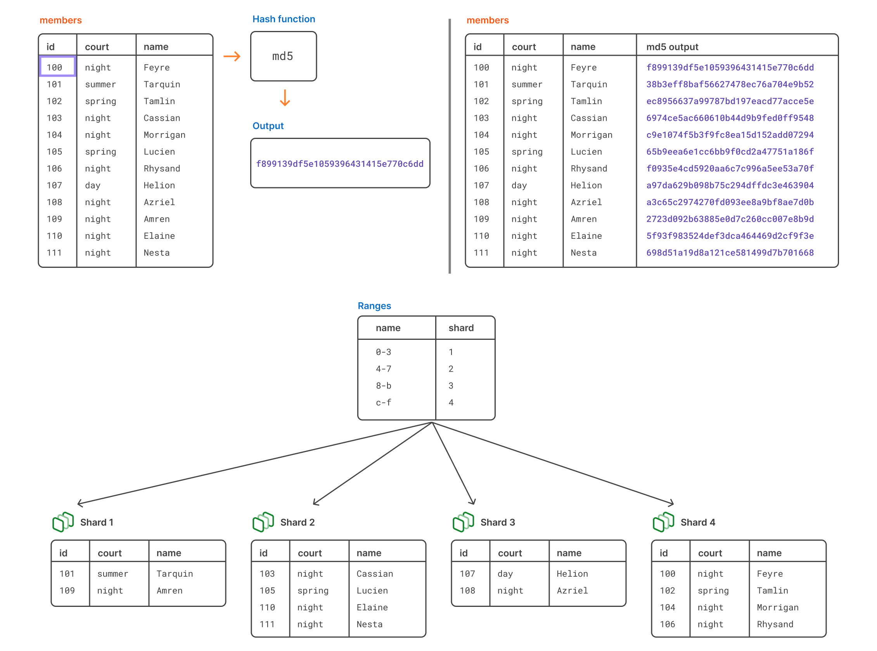
Types of Sharding
Hashed Sharding: Example

Slide 27
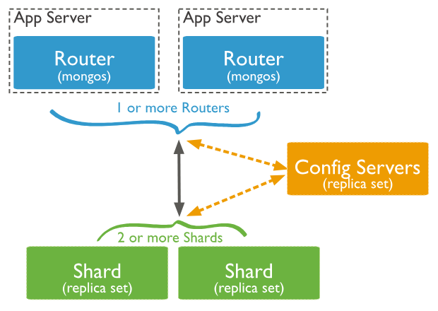
Data Routing and Query Execution
Query Router (mongos):
Determines which shards store the required data.
Sends queries to relevant shards only, optimising query performance.
Config Servers:
Maintain the cluster's metadata (e.g., shard key ranges).
Update and distribute metadata to query routers.
Sharding ensures queries are processed efficiently, even for massive datasets.
https://www.mongodb.com/docs/manual/sharding/

Slide 28
Challenges and Considerations
Choosing the Right Shard Key:
Poor shard key choice can lead to unbalanced data distribution ("hot shards").
Increased Complexity:
Requires additional management for config servers and query routers.
Operational Costs:
More resources are needed to maintain a sharded cluster.
More Details on Sharding: https://www.mongodb.com/docs/manual/sharding/

Slide 29
Comparing Replication and Sharding
Replication:
Provides data redundancy and high availability by copying data across multiple nodes.
Ensures data consistency across replicas.
Sharding:
Enables horizontal scaling by splitting data into smaller parts (shards) across multiple nodes.
Distributes data and read/write operations to balance the load.
Difference in Purpose:
Replication is about fault tolerance and availability
Sharding is about managing scale and performance.

Slide 30
Applications of Replication and Sharding in Real Life
Replication:
E-commerce platforms requiring continuous availability.
Financial applications where redundancy ensures data recovery.
Distributed applications with users in different regions can benefit from replica sets by directing local reads to nearby secondaries.
Sharding:
Social media applications managing large volumes of user data and activity logs.
IoT systems collecting and processing data from millions of devices.
Combining Both: Large-scale applications often use both for maximum availability and scalability.

Slide 31
Questions?

